Slide 1
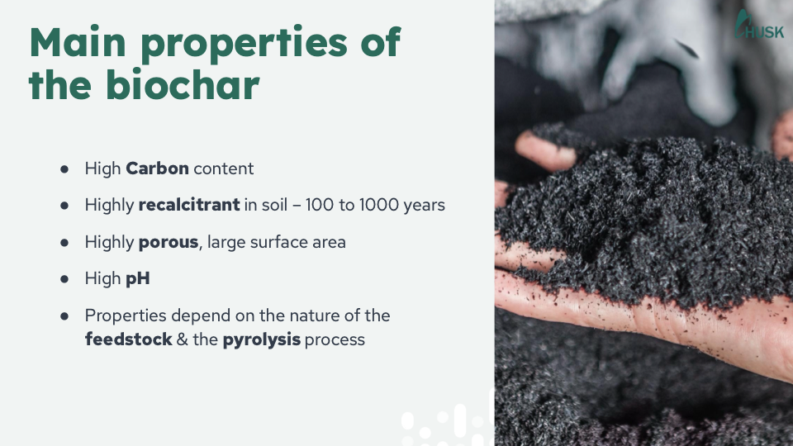
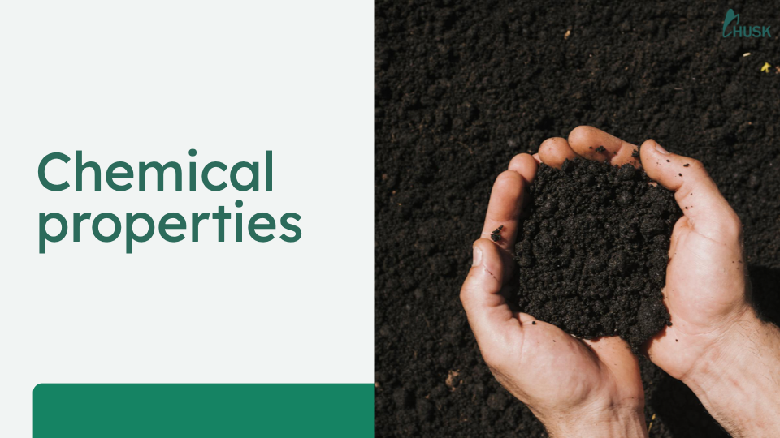

An Introduction to
Biochar.
Notes:
ECHO Asia seeks to honor God through serving our neighbor, specifically through the provision of tested, low-cost, easy-to-implement agricultural options suitable for the smallholder farmer.
Biochar is one of these options.
Photos: Husk, 2025

Slide 2
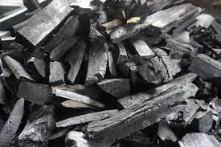
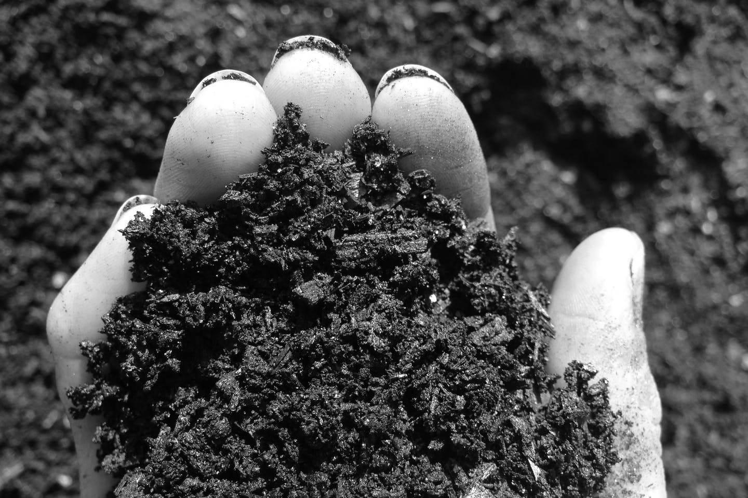
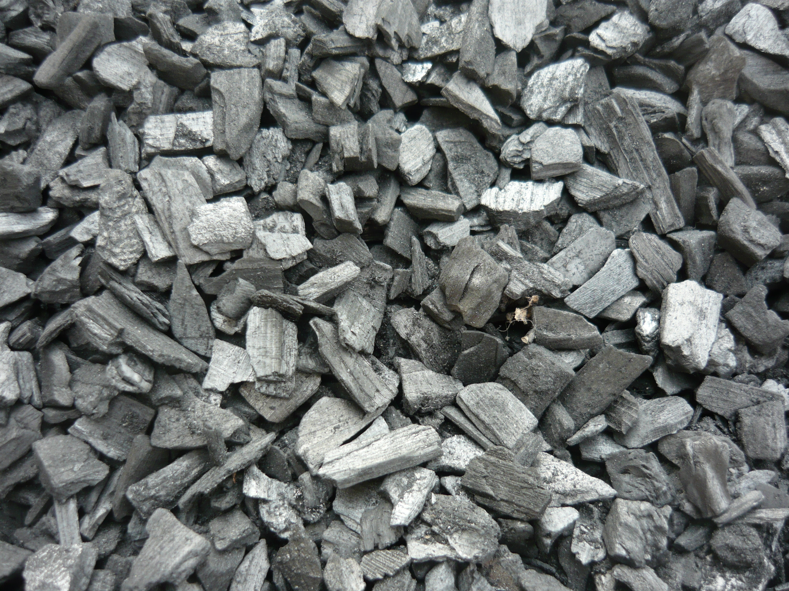
What do you already know?
.
Turn to your neighbor and discuss: What is Biochar?
Together, draft a 1-2 sentence definition
Notes:
But what is Biochar?
Turn to your neighbor and discuss.
Together, draft a 1-2 sentence definition. Be ready to share your thoughts.
Photos:

Slide 3
What is Biochar?
Notes:
So, we’ve just brainstormed a few ideas about biochar. But, what is the actual definition?

Slide 4
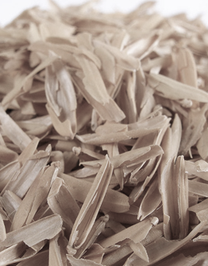
Biochar begins with biomass.
This material, also called “feedstock,” is a collection of organic material that will be used as a fuel.
Notes:
Well, biochar begins with biomass.
This material, also called “feedstock,” is a collection of organic material that will be used as a fuel.
Any organic material is suitable as long as it is very dry. Ideally, our biochar will be created using organic waste material, such as rice hulls, orchard prunings, corn cobs, one-use bamboo chopsticks, etc. In this way, waste can be turned into a resource!
Photo:

Slide 5
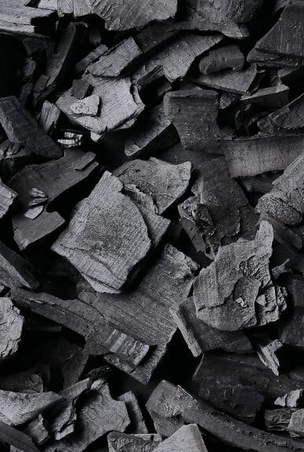
All organic material is carbon-based.
So, when biomass is burned in an open fire, this carbon combines with oxygen and is released as carbon dioxide (CO₂).
Notes:
All organic material is carbon-based.
So, when biomass is burned in an open fire, this carbon combines with oxygen and is released as carbon dioxide (CO₂).
Photo:

Slide 6
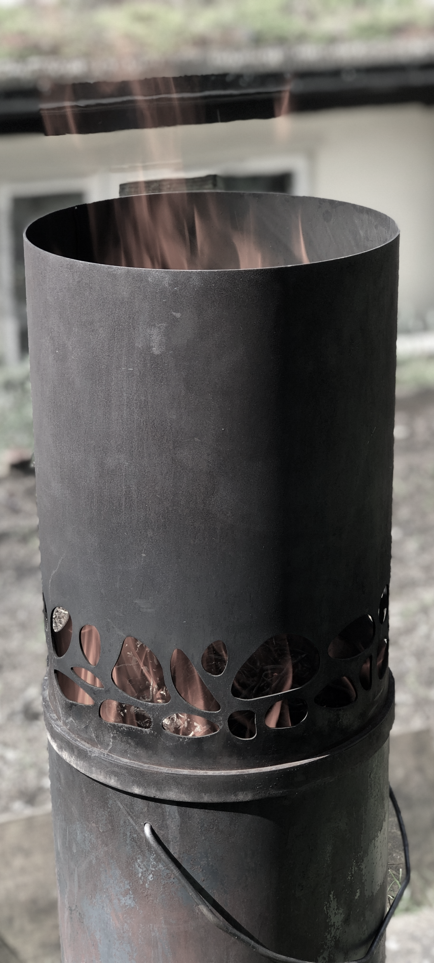
Pyrolysis is “the breakdown and volatilization of biomass under heat with limited or no oxygen.”
This restriction of oxygen means CO₂ production can be minimized, as the biomass can be broken down primarily into biofuel and biochar.
Notes:
In contrast, Pyrolysis, is “the breakdown and volatilization of biomass under heat with limited or no oxygen.”
In other words, when we restrict oxygen carbon dioxide production can be minimized, as the biomass can be broken down primarily into biofuel and biochar.
(*Volatilization is the process of changing a substance from a liquid or solid to a gas or vapor.)
Definition: A Farmer’s Guide to the Production, Use and Application of Biochar (Joseph & Taylor), 2024
Photo:

Slide 7
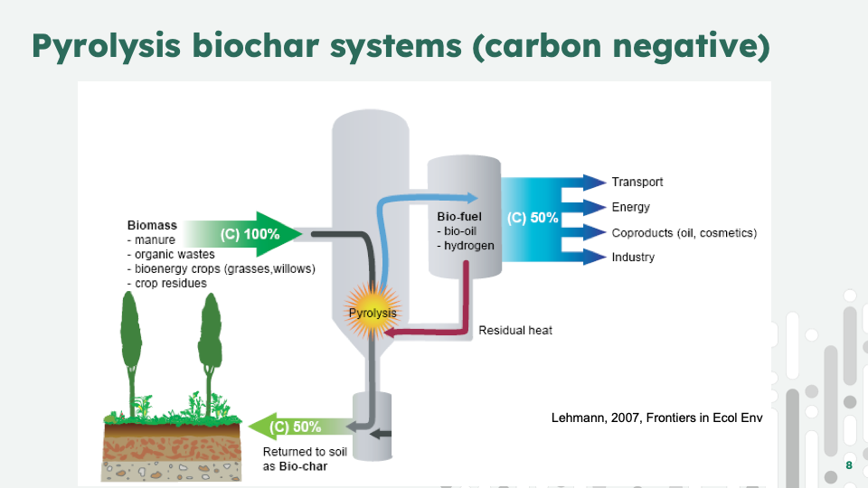
Results of Low-Temperature Pyrolysis
Notes:
As this diagram shows, about 50% of the biomass will be turned into biochar and about 50% will breakdown into biofuel. If our kiln does not capture the biofuel created, it will be released into the air.
This is important to understand in order to have a realistic picture of biochar. Biochar production, particularly on the small-scale agricultural level does not eliminate CO₂ or methane release. However, it does dramatically reduce it.
Image: Bio-energy in the black, Johannes Lehmann, 2007 (https://www.css.cornell.edu/faculty/lehmann/publ/FrontiersEcolEnv%205,%20381-387,%202007%20Lehmann.pdf)

Slide 8
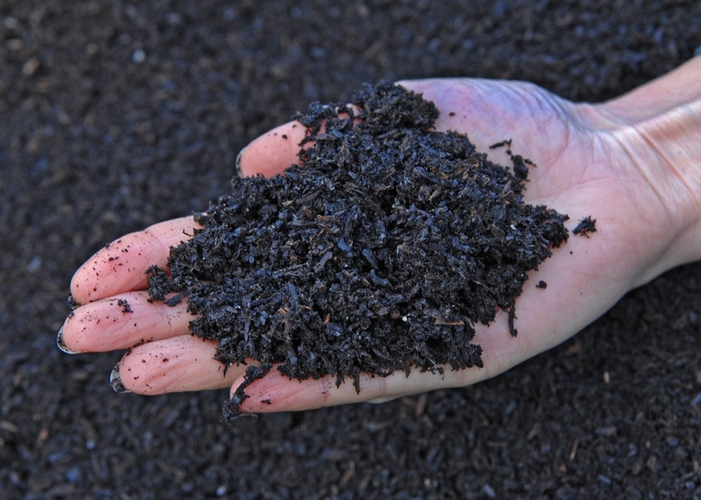
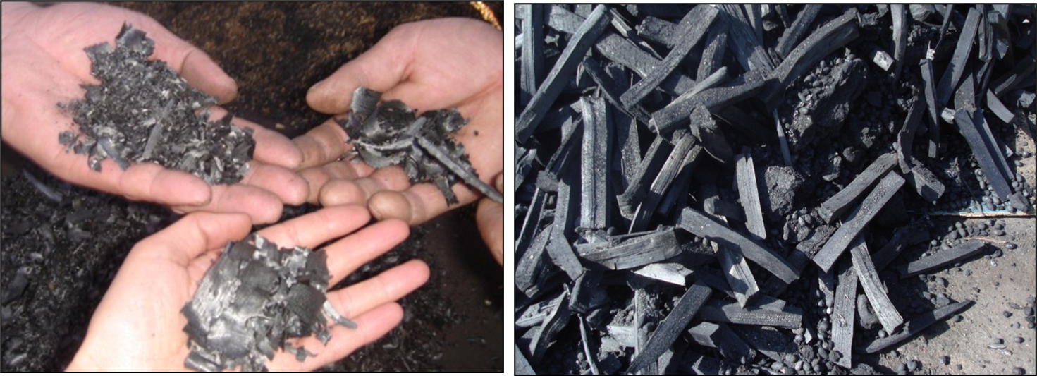
Biochar is “biomass that has undergone thermal decomposition in an oxygen-starved environment.”
It is a highly porous, charged, carbon-rich material.
Notes:
So, Biochar is “biomass that has undergone thermal decomposition in an oxygen-starved environment.”
It is a highly porous, charged, carbon-rich material.
Definition: A Farmer’s Guide to the Production, Use and Application of Biochar (Joseph & Taylor), 2024
Photo (R):
(L): https://www.farmprogress.com/soil-health/biochar-emerges-as-soil-amendment-for-agriculture

Slide 9
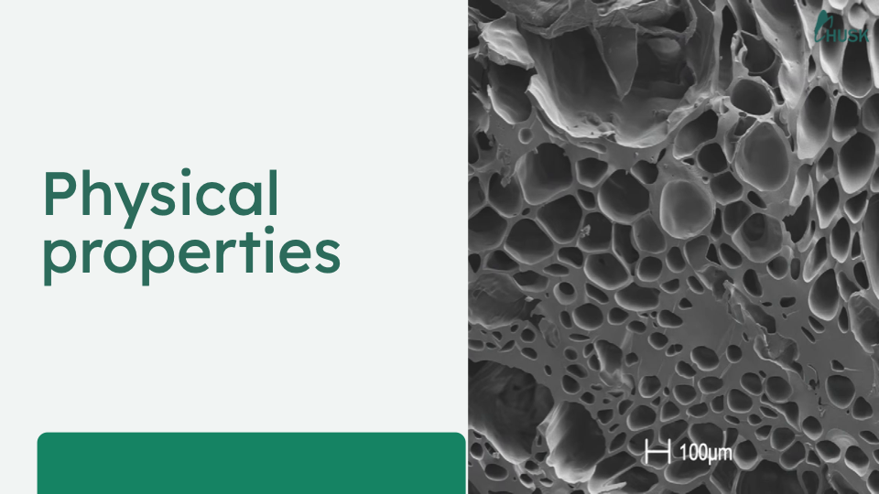
The Physical Properties of Biochar
Notes:
There are several physical properties of biochar that make it particularly valuable.
Photo: Husk, 2025

Slide 10
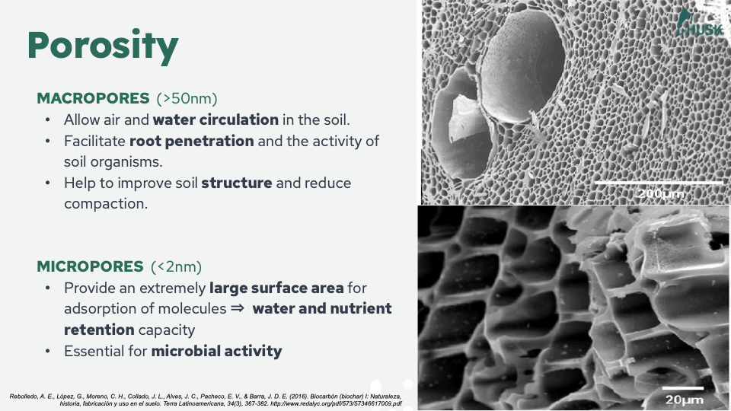
Porosity
Biochar is filled with billions of tiny holes.
Macropores (>50 nm)
Micropores (<2 nm)
Notes:
First, biochar is filled with billions of tiny holes. These macropores and micropores, measuring in only billionths of a meter, make biochar like a super sponge!
(*A nanometer--nm--is one billionth of a meter. A micrometer-–um—is one millionth of a meter)
Photos: Significance of biochar application to the environment and economy, Babalola Oni, Olubukola Oziegbe & Obembe Olawole, Annals of Agricultural Sciences, 2019 (https://www.sciencedirect.com/science/article/pii/S0570178319300405)

Slide 11
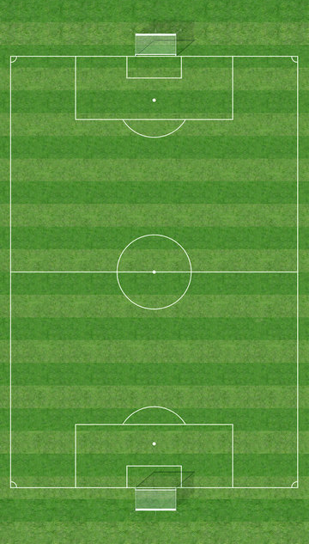
Specific Surface Area
Biochar’s porosity results in an incredibly high specific surface area.
Notes:
Second, biochar’s porosity results in an incredibly high specific surface area.
The exact specific surface area can vary based on the type of biomass and the specific production process used to create the biochar. However, as example, our partners at Husk produce rice husk biochar with a specific surface area of 225 m²/g. So, if they could “stretch” out the pores of their biochar, it would only take 22 grams to cover the entire surface of a professional football (soccer) pitch.
Photo: Adobe Stock, 2025 (https://stock.adobe.com/th/search?k=soccer+field+aerial&asset_id=12308191)

Slide 12
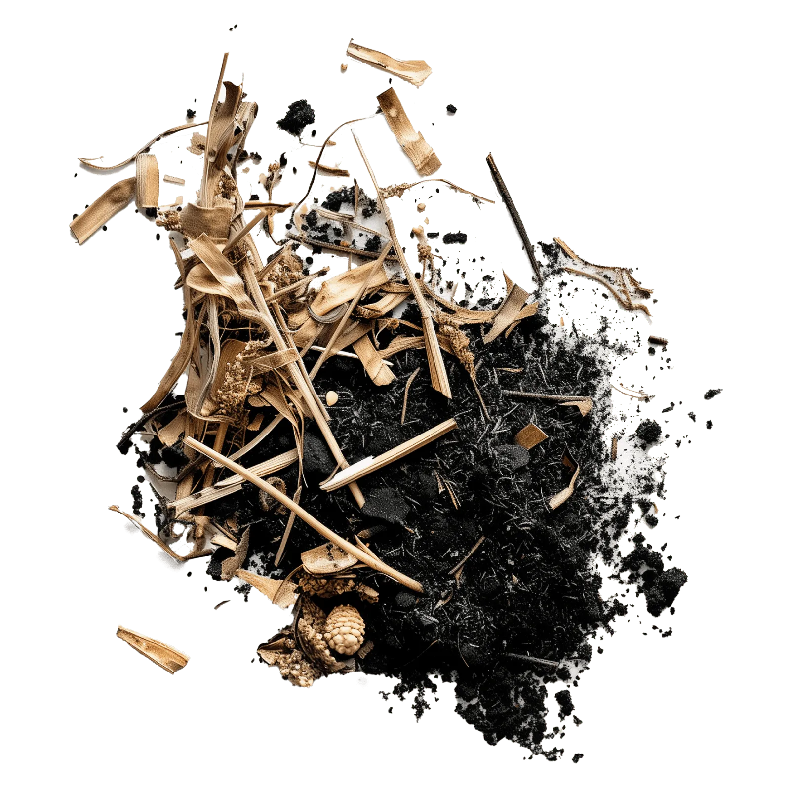
Permanence
Biochar is slow to breakdown in the soil.
Notes:
Biochar is also highly recalcitrant. This characteristic means it will stay present in the soil for 100, up to 1000, years without breaking down.
In fact, the Aztecs (450 BC-950 AD) used biochar in the creation of “Terra Preta” or black earth soils that can still be seen today…over 1000 years later!
Schmidt, H., Abiven, S., Hagemann, N., Meyer zu Drewer, J., 2022. Permanence of
soil applied biochar. The Biochar Journal 1, 69–74.
Photo: Klimate, 2025 (https://www.klimate.co/carbon-removal/methods/biochar)

Slide 13
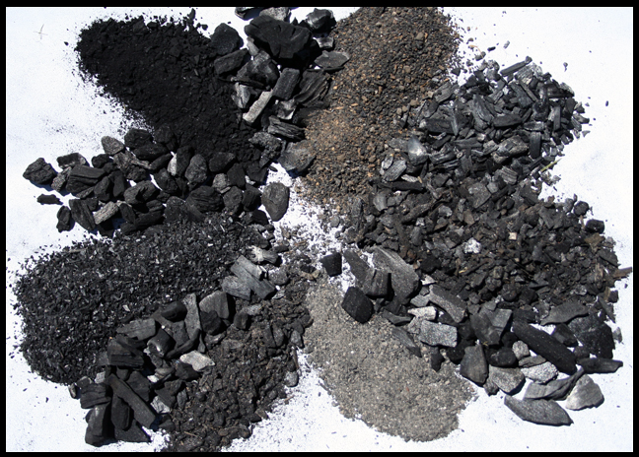
The Chemical Properties of Biochar
Notes:
Biochar also has several valuable chemical properties.
Photo: UC Davis Biochar Database, 2025 (https://biochar.ucdavis.edu/)

Slide 14
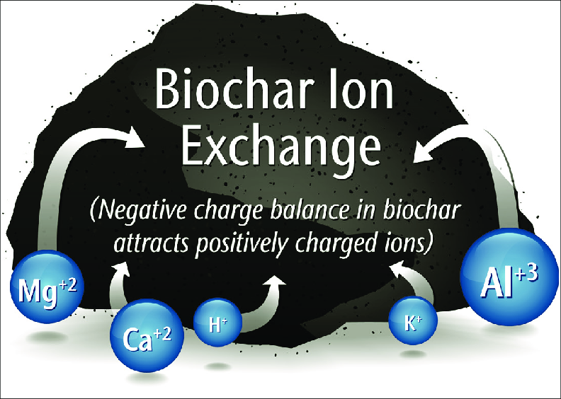
Cation Exchange Capacity
The surface of biochar is negatively charged. This attracts positively charged cations that attach to it.
Cation Exchange
Notes:
The most significant is biochar’s cation exchange capacity.
The surface of biochar is negatively charged. This attracts positively charged cations that attach to it. Essentially, the biochar acts like a magnet, drawing and holding positively charged cations against its surface.
Image: Biochar: Andrew Mack, PREC sourced in A Home Gardener’s Primer, Linda Chalker-Scott, 2014 (https://www.researchgate.net/publication/315663038_Biochar_a_gardener's_primer_WSU_Extension_Fact_Sheet_FS147E)
(Positively charged nutrients (cations) include: potassium, magnesium, nitrogen, calcium, ammonium. Negatively charged nutrients (anions) include nitrate, phosphate, and sulfate. Fortunately, they can be more easily leached out of the soil compared to cations)

Slide 15
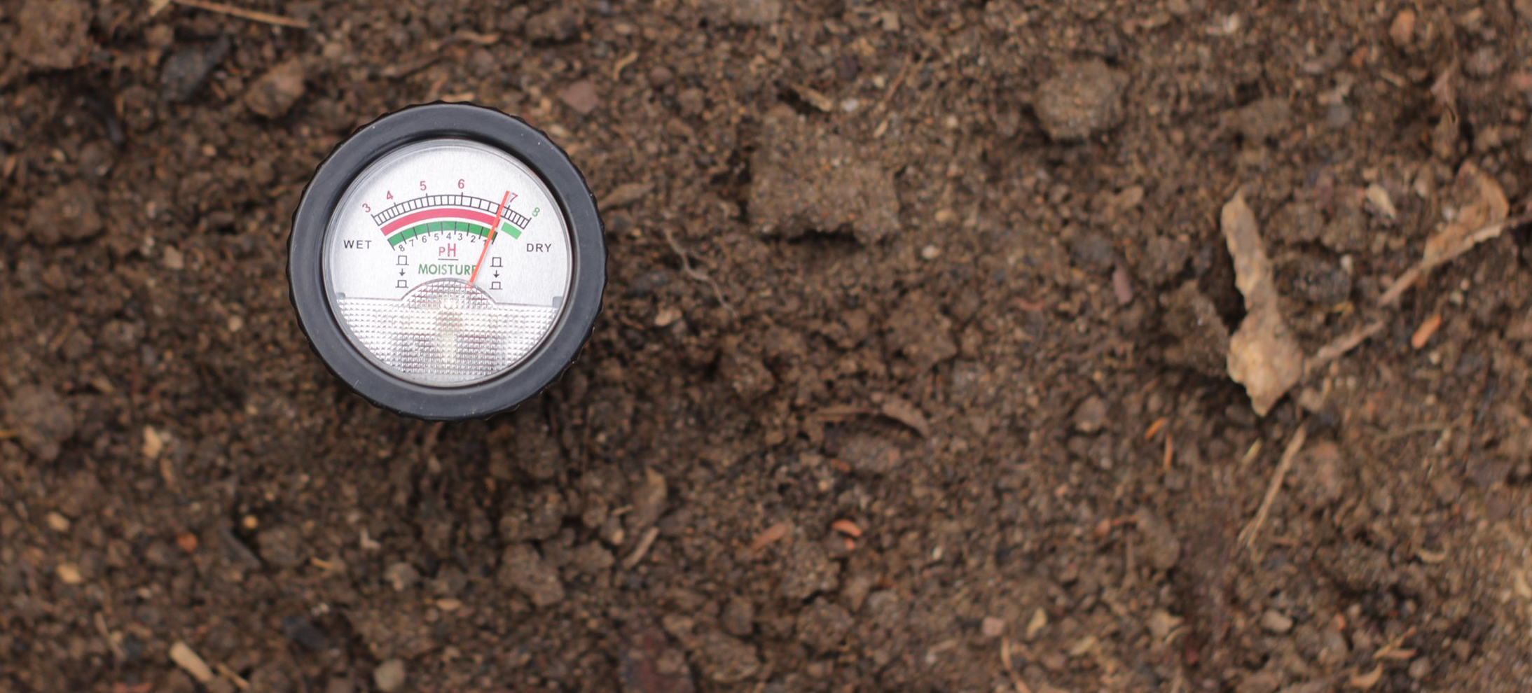
High pH
Biochar is neutral to alkaline (pH >7)
Notes:
Finally, biochar has a high pH, usually 7 or above, again dependent on the type of biomass and production process used to create the biochar.
Photo: Does Biochar Raise Soil pH? Wakefield, 2025 (https://wakefieldbiochar.com/learning-center/does-biochar-raise-soil-ph/)

Slide 16
How is Biochar created?
Notes:
Hopefully, you now have a better idea of what Biochar is. But how does pyrolysis work to create biochar?

Slide 17
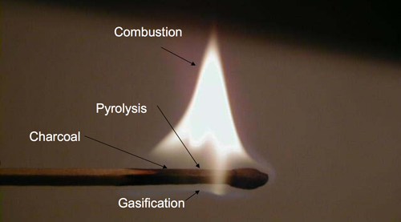
The Match Analogy
Notes:
Consider the humble match.
“Striking a match on the rough surface of the matchbox ignites a flaming chemical reaction of the sulfurous tip. This generates enough heat to make the wood release highly combustible gases. The flame ignites these gases …and the process continues as the heat from the burning gases causes further gas emissions and then the burning of that gas.
Underneath the flame of the burning gas, the wood itself does not burn. Instead, it carbonizes into biochar. This occurs because the gas flame consumes all the oxygen and so creates a pyrolysis zone where the flame protects the wood of the match from oxidation.”
Paraphrased from Schmidt HP, Taylor P: Kon-Tiki - the democratization of biochar production, the Biochar Journal 2014, Arbaz, Switzerland. (https://www.biochar-journal.org/en/ct/39)
Photo: Thomas Reed sourced in Schmidt HP, Taylor P. (https://www.biochar-journal.org/en/ct/39)

Slide 18
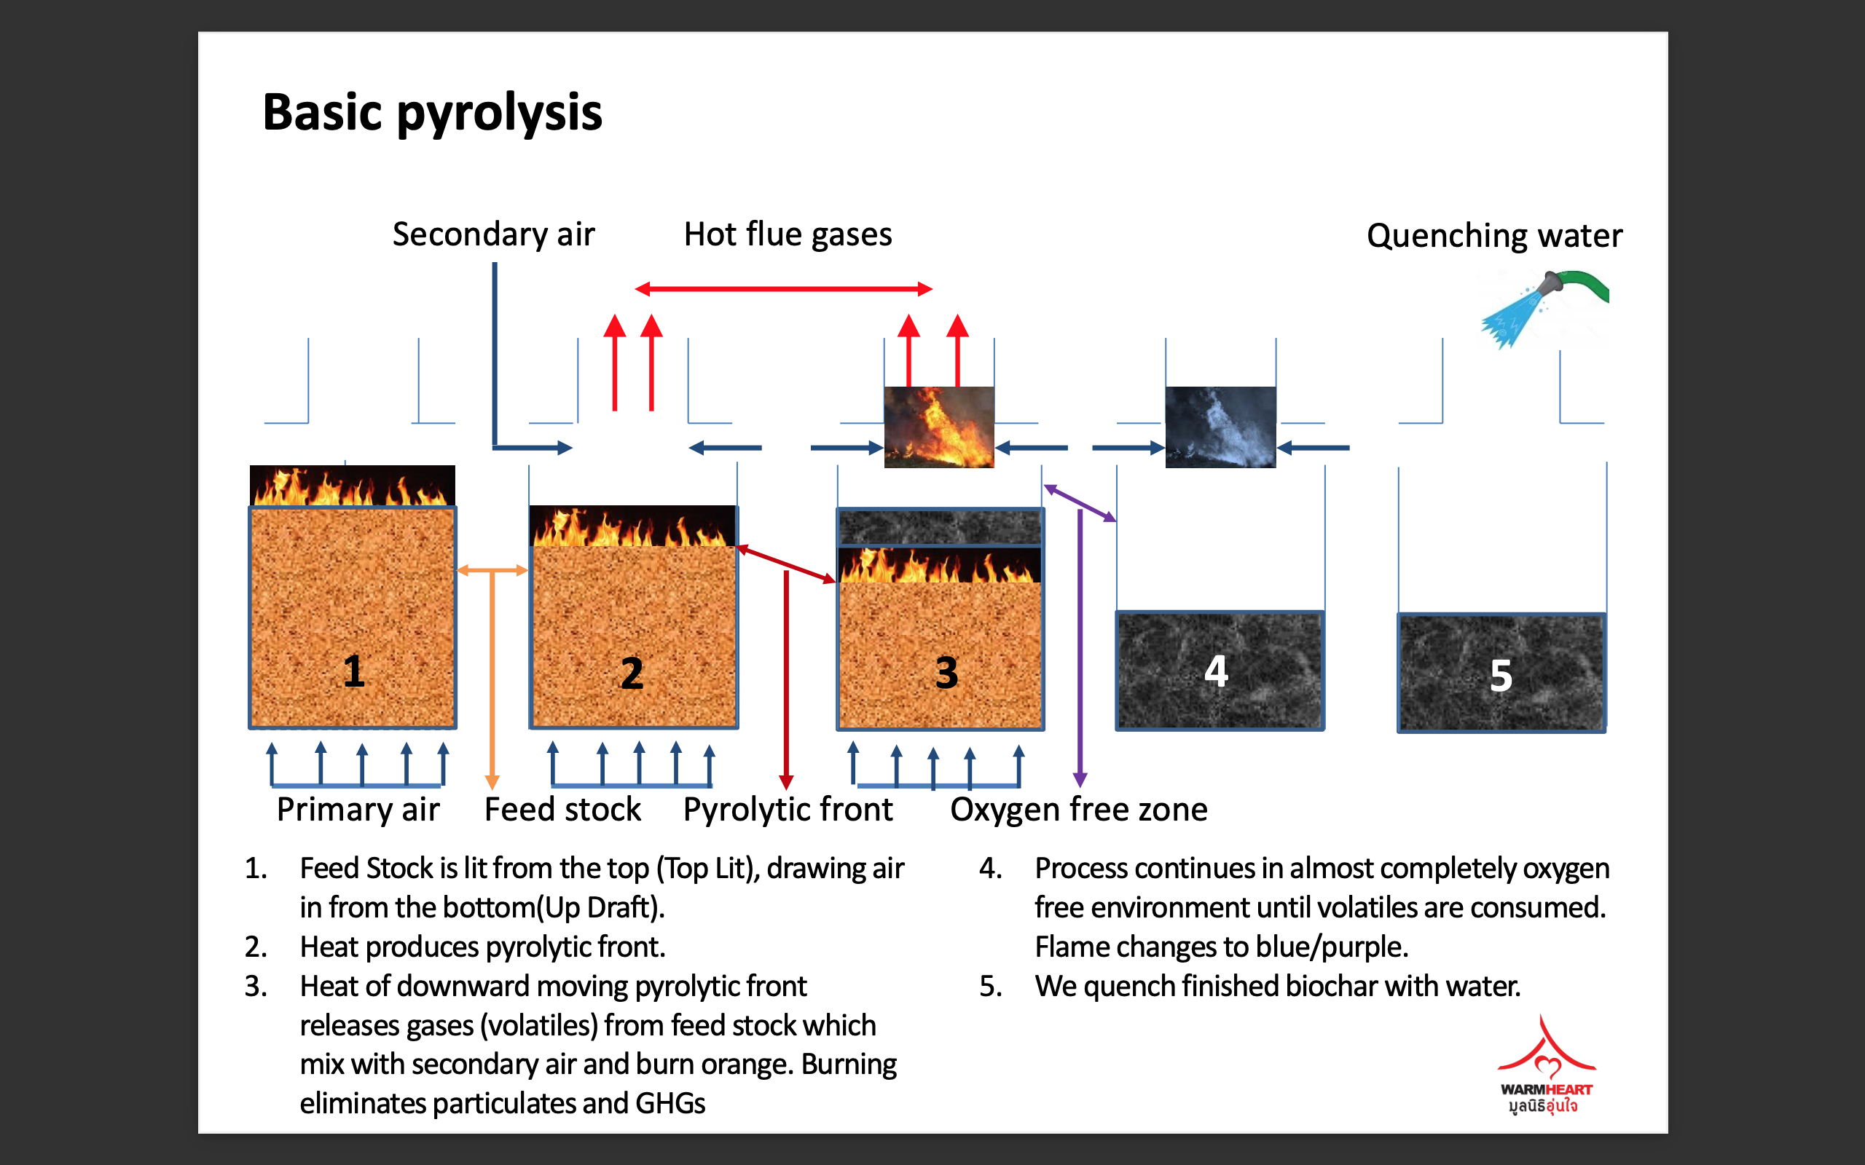
Top Lit Up Draft (TLUD) Pyrolysis
The biomass is lit from the top (“top lit”), drawing air in from the bottom (“up draft”).
The heat produces a pyrolytic front.
The heat of the downward-moving pyrolytic front releases gases that mix with the secondary air and burn.
The process continues in an almost completely oxygen-free environment until all the gas is consumed.
The finished charcoal is then quenched with water.
Notes:
TLUD, or Top Lit Up Draft, pyrolysis uses the same basic principle.
“The fire is lit from above. The heat generated in this uppermost layer heats the next lower layer, so that it begins to release gas. The gas rises through the flame, where it is burned.
Radiant heat from the flame chars the wood beneath layer by layer. While the air entering into the system is updrafted into the flame and consumed in combustion.
The process continues until all the gas is consumed. At this point, the biomass is fully charred. The fire is then put out (often with water) to prevent the biochar from turning into ash.
--Paraphrased from Schmidt HP, Taylor P: Kon-Tiki - the democratization of biochar production, the Biochar Journal 2014, Arbaz, Switzerland. (https://www.biochar-journal.org/en/ct/39)
--Image: Biochar Life, ?

Slide 19
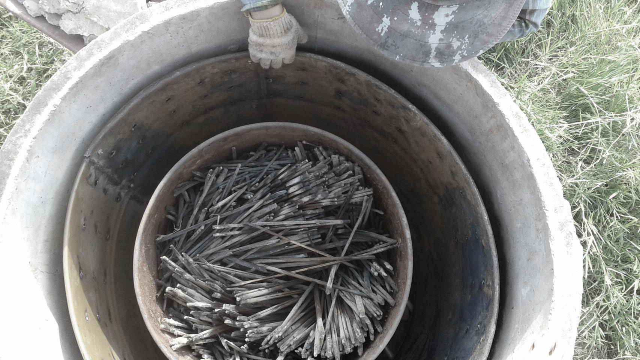
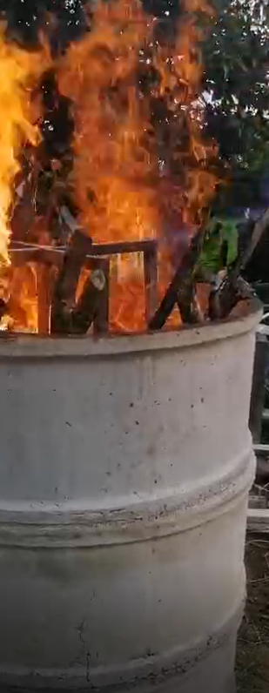
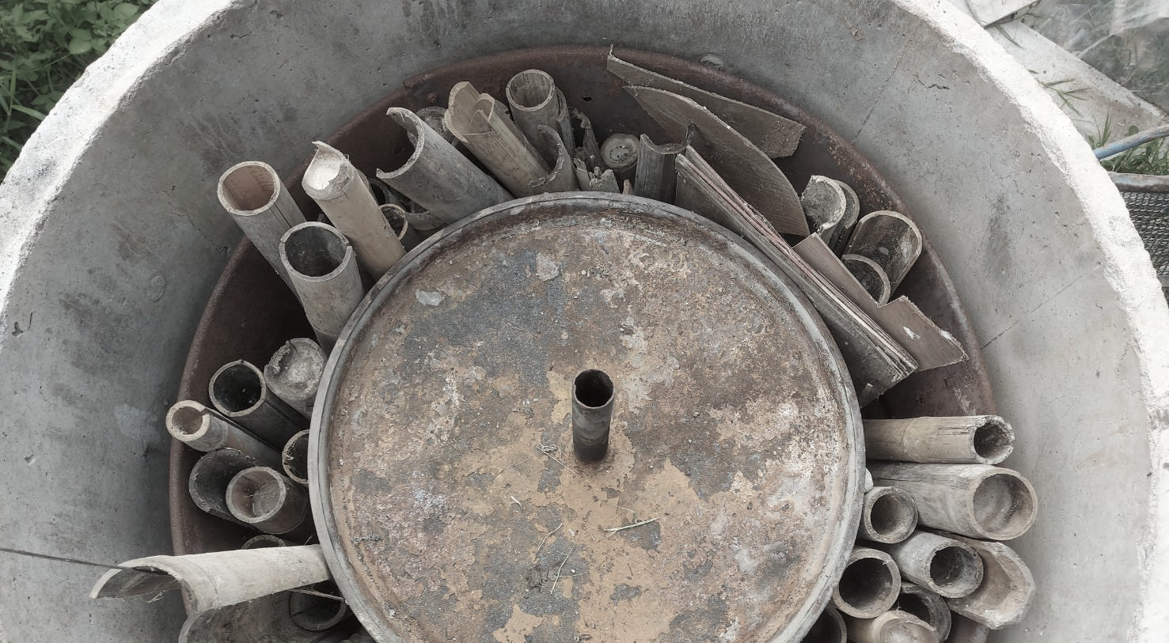
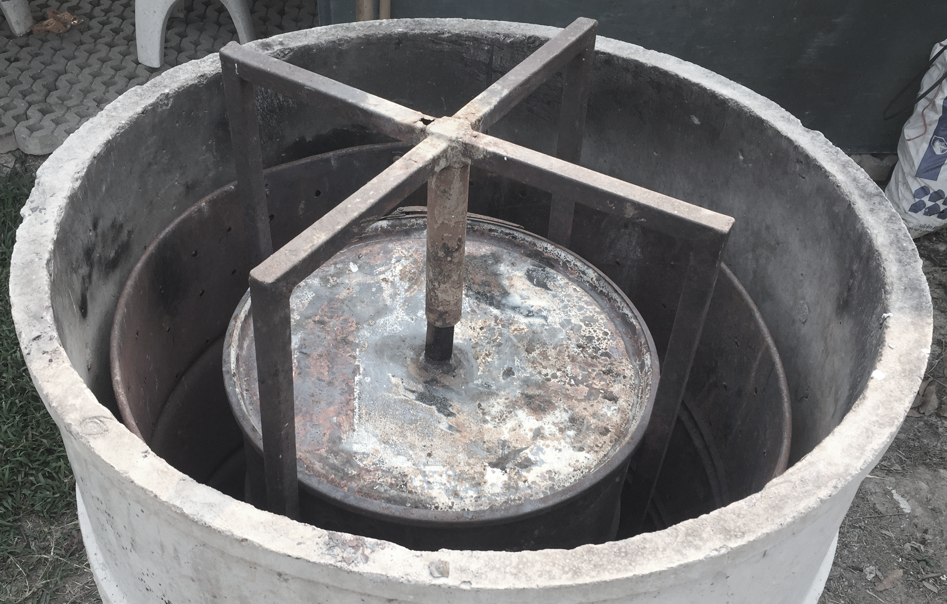
Retort Pyrolysis
In a Retort system, the biomass is isolated in an airtight chamber (B) separate from the fire (A).
The heat from the outer fire triggers the breakdown of biomass in the airtight chamber.
B
A
Notes:
In a Retort system, the biomass to be charred is isolated in an airtight chamber (B) separate from the fire (A).
The heat from the outside fire triggers the charring of biomass in the airtight chamber. Gas produced in this chamber is fed back into the fire to be burned. The biomass will continue to release gas until all that remains is fully carbonized biochar.
Photos: ECHO Asia, ?

Slide 20
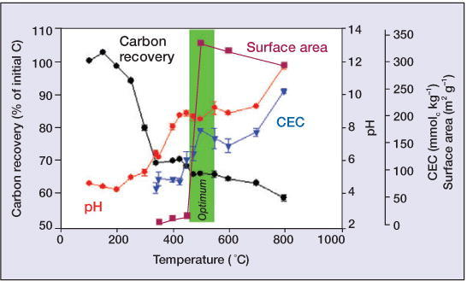
Optimal Heat Range for Biochar Production for Ag Applications
Notes:
Simple kilns like those just shown are suitable for smallholder farmers. The high heat of industrial kilns are not necessary as the optimal heat for biochar production for agricultural applications is in the 400-600$℃$ range, which is exactly the heat range of these homemade kilns. This heat allows for optimal pH, surface area, carbon recovery, and cation exchange capacity.
Image: Bio-energy in the black, Johannes Lehmann, 2007 (https://www.css.cornell.edu/faculty/lehmann/publ/FrontiersEcolEnv%205,%20381-387,%202007%20Lehmann.pdf)

Slide 21
Got it? ☺
Notes:
So, how are you feeling so far? Any questions about what biochar is or how it is created?

Slide 22
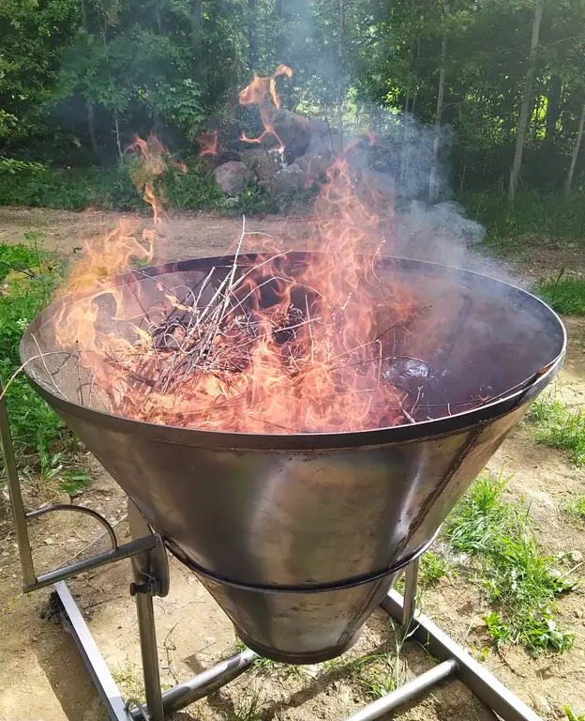
It’s time for a quiz!
What kind of biomass should be used for biochar production?
What is minimized during pyrolysis that helps us reduce the amount of CO₂ released?
What are three valuable physical properties of biochar?
What are two valuable chemical properties?
What are the two types of pyrolysis generally used in the kilns implemented by smallholder farmers?
Notes:
If not, it’s time for a quiz!
What kind of biomass should be used for biochar production?
What is minimized during pyrolysis that helps us reduce the amount of CO₂ released?
What are three valuable physical properties of biochar?
What are two valuable chemical properties?
What are the two types of pyrolysis generally used in the kilns implemented by smallholder farmers?
Photo: Beyond Buckthorns, 2025 (https://www.beyondbuckthorns.com/content/kiln/plans-build-kontiki-kiln-charcoal-making)

Slide 23
Why Biochar?
Notes:
Of course, no one wants to go to the trouble of implementing new ideas on their farm unless there is a clear benefit.
So, why biochar?

Slide 24
Reason 1:
Soil Health
Notes:
The most compelling reason for biochar production is to promote soil health.

Slide 25
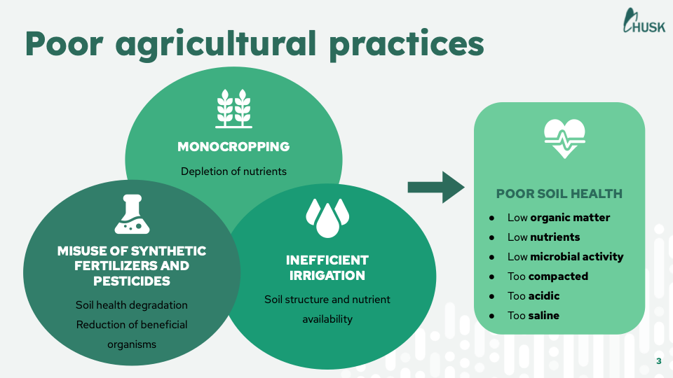
Biochar can help us address some of the Problems caused by Poor Agricultural Practices…
Notes:
Globally, about 40% of our land mass is used for agriculture. About 1/3 of this land is used to grow crops; the remaining 2/3 is used for livestock.
Unfortunately, we have not always been good stewards of our resources. In particular, monocropping, inefficient irrigation, and misuse of synthetic fertilizers and pesticides have contributed significantly to the degradation of our soils. According to the UN, about 34% of our agricultural land is degraded. This means that farmers are working with soils that are low in organic matter, low in nutrients, low in microbial activity, overly compacted, too acidic, and too saline.
Land use in agriculture by the numbers, FAO, 2020 (https://www.fao.org/sustainability/news/detail/en/c/1274219/)
World Development Indicators DataBank, World Bank Group, 2025 (https://databank.worldbank.org/reports.aspx?source=2&series=SP.POP.TOTL&country=WLD)
Global Land Outlook, UNCCD, 2022 (https://www.fao.org/family-farming/detail/en/c/1507023/)
The State of the World’s Land and Water Resources for Food and Agriculture – Systems at breaking point, FAO, 2021 (https://openknowledge.fao.org/items/55def12b-2a81-41e5-91dc-ac6c42f1cd0f)
Image: Husk, 2025

Slide 26
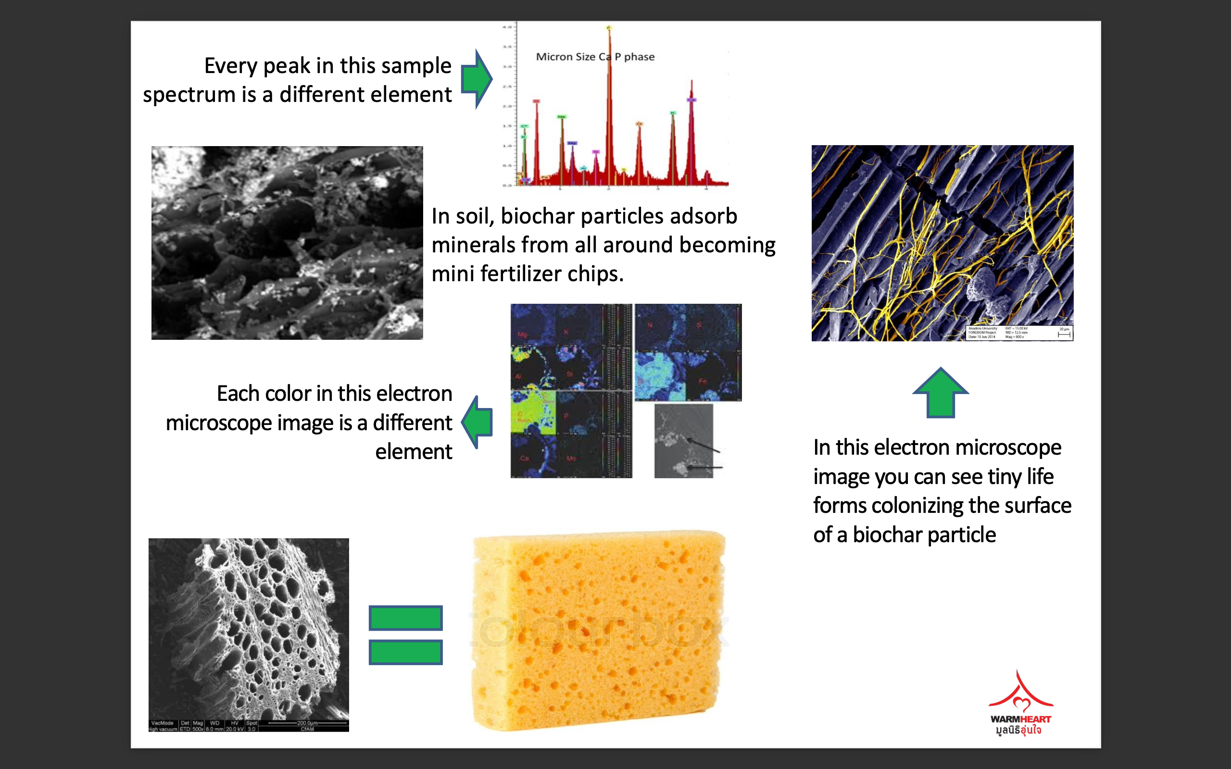
Benefits of Biochar Structure
Water Use Efficiency
Nutrient Storage
“Hotel” for Beneficial Microorganisms
Long-term Soil Amendment
Notes:
It would be overly naïve and unrealistic to say that biochar is the solution to all our soil problems. However, it certainly can be a meaningful part of the solution.
Remember that biochar is a highly porous material that can remain in the soil for hundreds of years. This makes it an important tool for increasing water use efficiency, storing nutrients for plant uptake, and housing beneficial microorganisms on a long-term basis.
For example, macropores create space for air and water circulation in the soil. This means that soils can more effectively drain water in the case of heavy rain or bad irrigation. At the same time, micropores can help to hold water in situations of drought. The incredible surface area of the biochar provides space for nutrients to be held. In turn, the presence of these nutrients, “the water-holding capacity, and the pore structure of biochar provides a good habitat for soil microorganisms and are conducive to their growth and reproduction.”
Impacts and mechanisms of biochar on soil microorganisms, Kai Huang, Jun Zhang, Guangming Tang, and Da Bao, Plant, Soil and Environment, 2023 (https://www.researchgate.net/publication/368529826_Impacts_and_mechanisms_of_biochar_on_soil_microorganisms)
Image: BiocharLife, ?

Slide 27
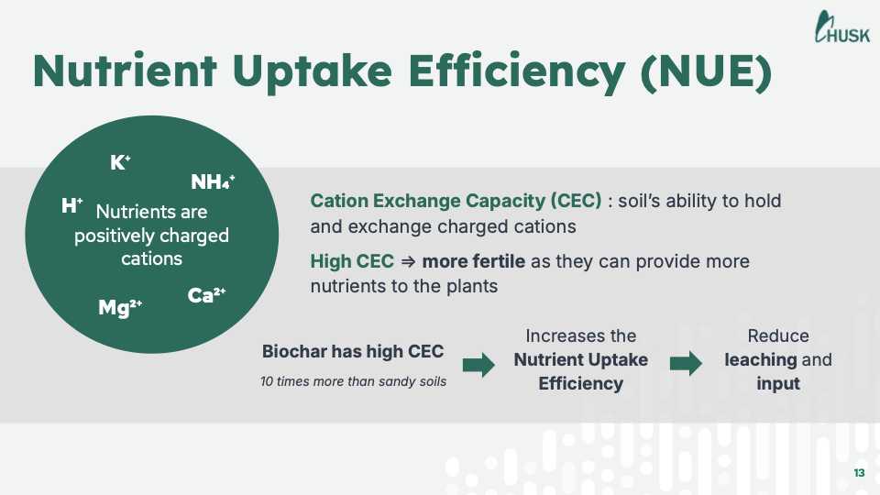
Benefits of Biochar Chemistry
Nutrient Storage
Increased Soil Enzyme Activity
Reduced Pollutant Concentration
Regulation of Soil Acidity
In the soil, biochar absorbs minerals becoming a small fertilizer chip.
Notes:
In actual fact, the physical structure and the chemical properties of biochar work together to create a valuable resource. So biochar’s porosity combined with its high cation exchange capacity (CEC) allows it to draw and hold nutrients. These nutrients are then slowly released into the soil, which helps avoid leaching or volatilization of nutrients and supports microbial activity. Beyond nutrient storage, the chemical properties of biochar also allow it to positively influence soil enzyme activity, reduce pollutant concentration in the soil, and help regulate soil acidity.
Impacts and mechanisms of biochar on soil microorganisms, Kai Huang, Jun Zhang, Guangming Tang, and Da Bao, Plant, Soil and Environment, 2023
Image: BiocharLife, ?

Slide 28
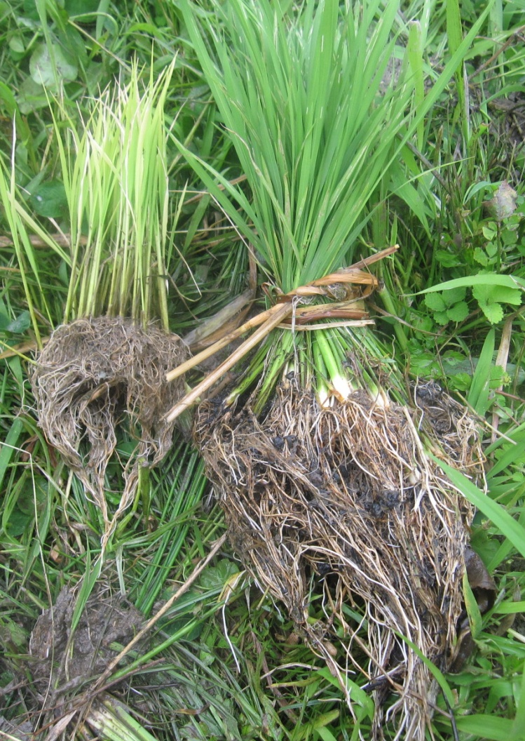
So,
does it work?
Notes:
Of course, anyone can make an appealing promise. But what do the results show?
This picture shows rice seedlings grown in two different mediums.
The seedlings on the left were grown in regular untreated soil.
The seedlings to the right were grown in a plot treated with a biochar-compost mix that was charged for 3 months before being applied to the soil.
As you can see, the health of the seedlings is dramatically different as the seedlings on the right have stronger root systems, more robust foliage and shoots, and better color.

Slide 29
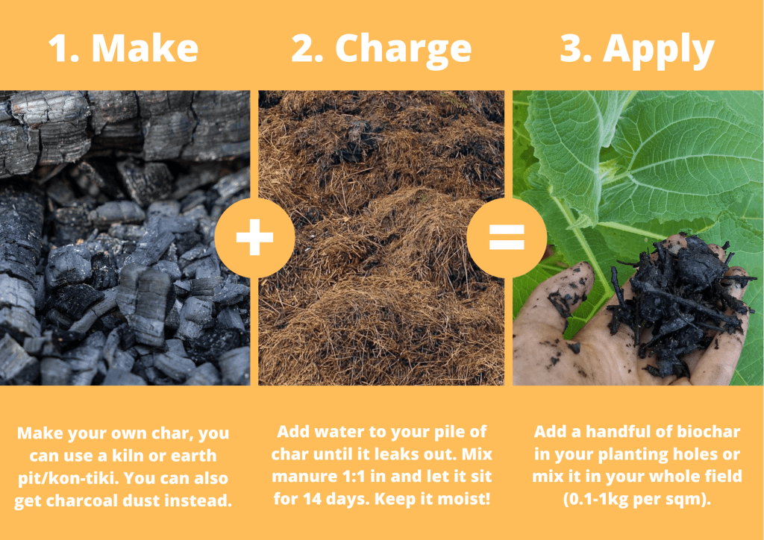
Biochar Must be “Charged” Before being Added to the Soil
Notes:
However, there is one important step that cannot be skipped when applying biochar to the soil.
Remember that biochar is essentially an incredibly absorbent sponge with magnetic super powers. But when it is made, it is essentially empty. This means that if we immediately add it to the soil without first filling it with resources, it will pull water and nutrients from the soil itself. If our soil is already poor, this means that the biochar will effectively “rob” our soil of the resources it needs.
So before we add biochar to the soil, we always “charge” it. Essentially, we want it to be stocked full of water, nutrients, and even some microorganisms BEFORE adding it to the soil so that it has many resources to share. This involves mixing our biochar with a wet nutrient source.
The fastest option is to charge biochar using urine or mature manure/compost tea. This brew should sit for 3 days, with occasional stirring, before it is ready for use.
A second option is to charge biochar using fresh manure at a 1:1 ratio. This mixture should sit for 2 weeks and be kept moist. Then, it is ready for use.
The final option is to mix our biochar with compost though it should represent no more than 20% of the compost pile. It is ready to use when the compost has finished decomposing (about 2-3 months).
--The Use of Biochar in Composting, Camps, University, Tomlinson, 2015 (https://biochar-international.org/wp-content/uploads/2023/01/Compost_biochar_IBI_final.pdf)
--Biochar: An Organic House for Soil Microbes, Hugill, 2013 (https://www.echocommunity.org/en/resources/070b6c33-4118-43c2-a26c-af58c60fe51a)
--Biochar Practical Guide, Olivia Thierley, 2020 (https://bottom-up-biochar.com/wp-content/uploads/Biochar-Practical-Guide.pdf)
--Biochar 101: How to Enrich Your Compost With Biochar, Urban, 2020 (https://fleetfarming.org/biochar-101-how-to-enrich-your-compost-with-biochar/#:~:text=We%20want%20to%20increase%20surface,has%20a%20tremendous%20surface%20area.)

Slide 30
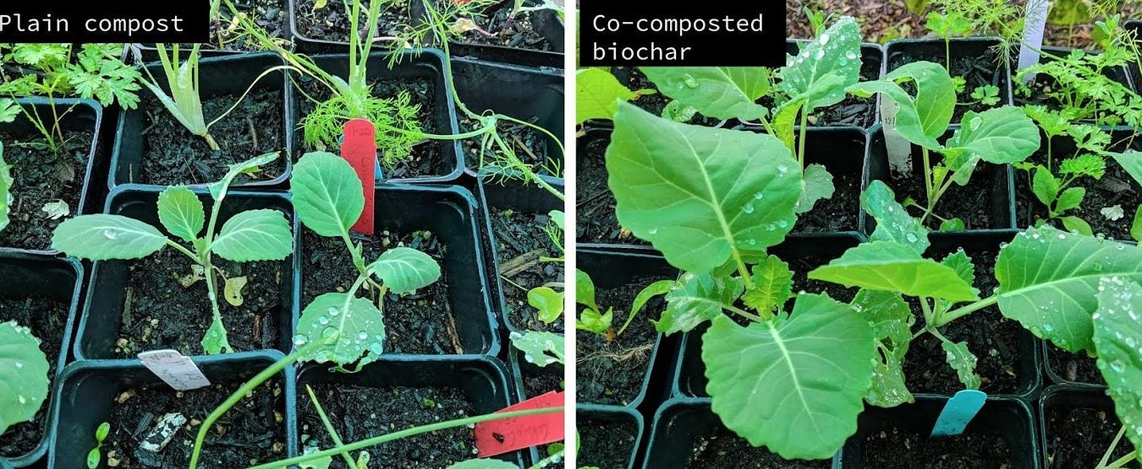
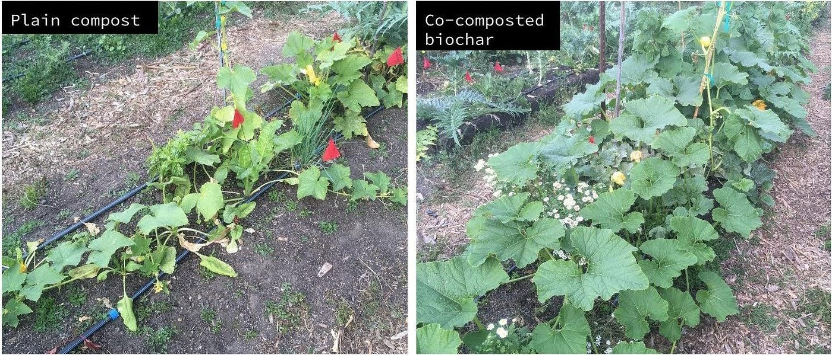
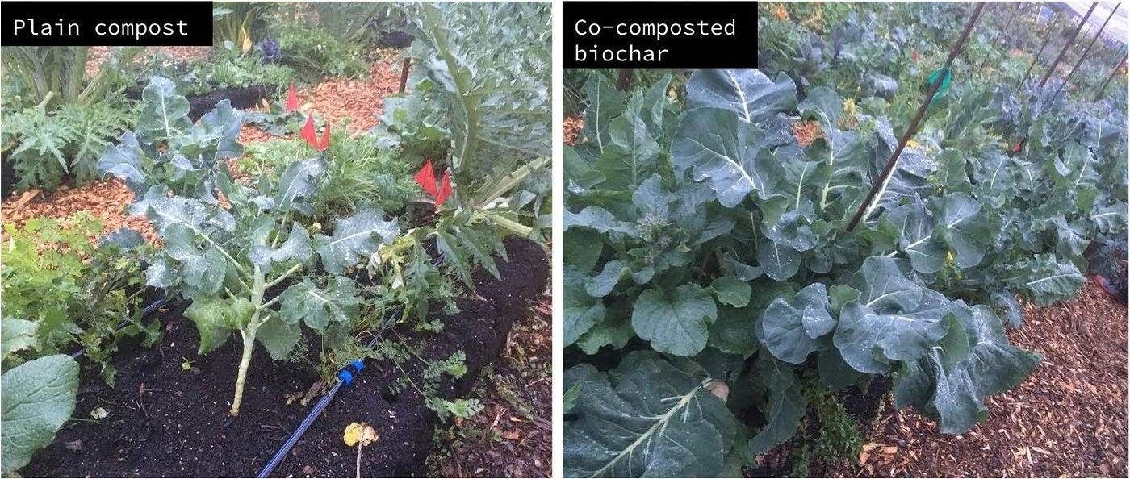
How to Apply Biochar to the Soil...
Root Zone Application
Surface Application
Notes:
Biochar is most effective in the soil around plant roots. So, ideally, the farmer will apply biochar when planting and add it to the planting holes or in the soil underneath where she will plant the seeds.
However, charged biochar can also be applied to existing plants by adding it to the soil around the plant base. If there is mulch on the soil surface, the biochar should be added under the mulch layer.
--Biochar Practical Guide, Olivia Thierley, 2020 (https://bottom-up-biochar.com/wp-content/uploads/Biochar-Practical-Guide.pdf)
--Pictures: A Perspective on Terra Preta and Biochar, All Power Labs, Accessed 2023 (https://www.allpowerlabs.com/terra-preta)

Slide 31
Reason 2:
Clean Water
Notes:
A second compelling reason for biochar production is clean water.

Slide 32
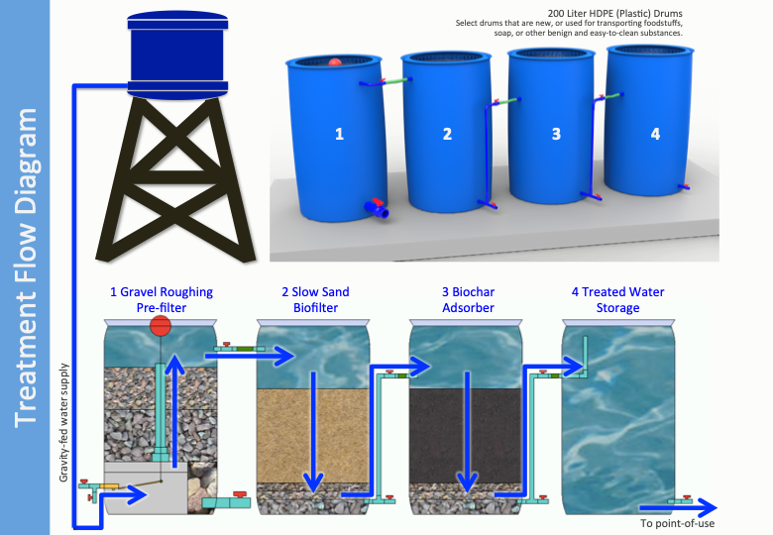
Biochar can be used to Filter Water…
Notes:
Biochar’s high porosity and charged surface allow it to adsorb chemicals, including heavy metals, and pathogens, effectively removing them from water. It can also help to absorb strong odors.
According to the World Health Organization and UNICEF, more than 2 billion people lack access to clean drinking water. This means that simple water treatment systems, like the biosand-biochar system pictured, are incredibly important.
--”Water Pollution from and to agriculture”, Water Action Decade, 2017 (https://wateractiondecade.org/2017/12/09/water-pollution-from-and-to-agriculture/)
--”1 in 3 people globally do not have access to safe drinking water – UNICEF, WHO”, World Health Organization, 2019 (https://www.who.int/news/item/18-06-2019-1-in-3-people-globally-do-not-have-access-to-safe-drinking-water-unicef-who/)
--Image: “300 L/d Water Treatment System Graphical Manual”, AqueousSolutions, 2016 (https://www.aqsolutions.org/charcoal-biochar-water-treatment/)

Slide 33
Reason 3:
Healthy Air
Notes:
If you have heard of biochar before today, it is most likely that you have heard about it in relation to removing carbon from the air.

Slide 34
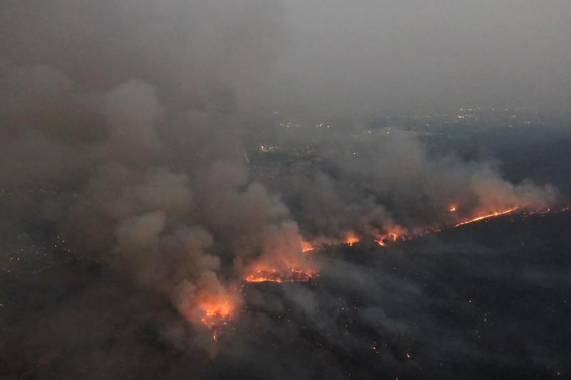
Biochar can help reduce the amount of CO₂ release…
Notes:
As residents of Southeast Asia, we are all aware of the challenges we face each year as a result of agricultural burning and forest fires. Our partners at BiocharLife did some number crunching and determined that burning one tonne of biomass creates just over 6 kg of PM2.5. And in Northern Thailand alone, we burn at least 322,000 tonnes per year! Obviously, the problem is vast.
As was mentioned earlier, biochar is not the solution to this problem as CO₂ and methane gases are still released in the biochar production process. However, burning for biochar and open burning are not the same. Biochar production can significantly reduce the amount of CO₂ released into the air. At the same time, agricultural waste is turned into a valuable resource for soil health and clean water.
--BiocharLife
--Photo:

Slide 35
Reason 4:
Renewable Energy
Notes:
A fourth benefit of biochar is its potential as a renewable energy source.

Slide 36
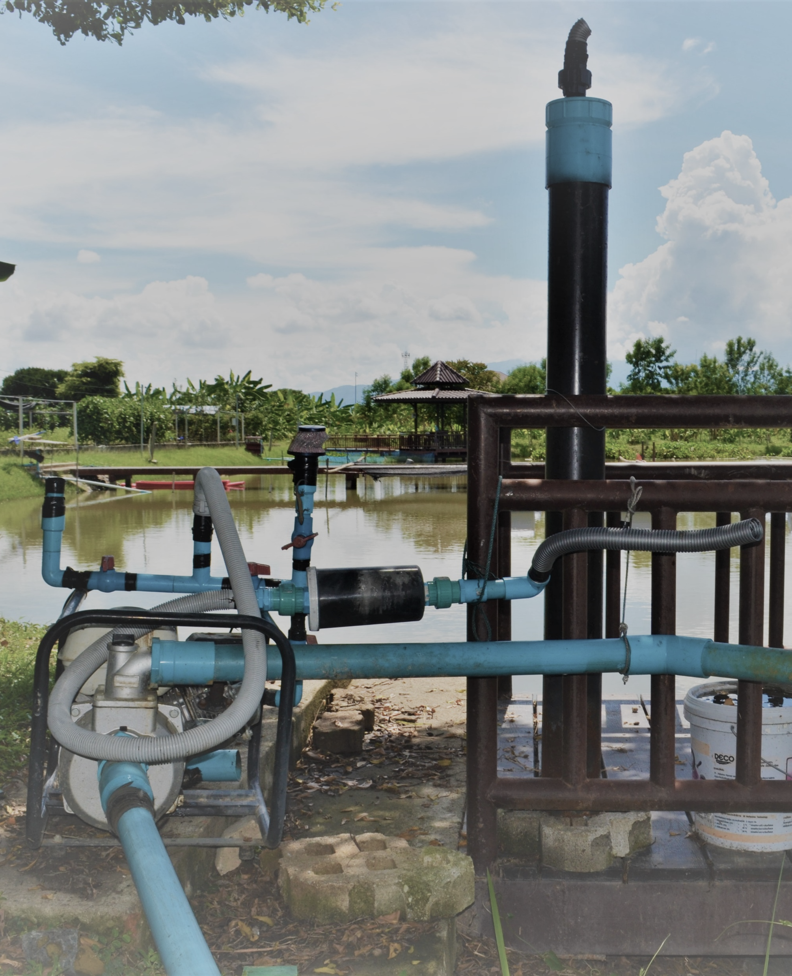
Biochar has Potential as a Renewable Energy Source…
Notes:
Anytime biomass is burned, there is a lot of heat generated. At the same time, gases are released. These outputs can be used in large-scale, industrial application to contribute to energy production.
On the small-scale, ECHO Asia has experimented with burning biochar in a special kiln, collecting the gas released, and using it to run a combustion engine. One burn using our kiln can produce enough fuel to run the engine for one to one and a half hours.
We are by no means expert in this application, but our small successes do open the door to further experimentation of how a smallholder farmer could harness this potential.
Photo: ECHO Asia, ?

Slide 37
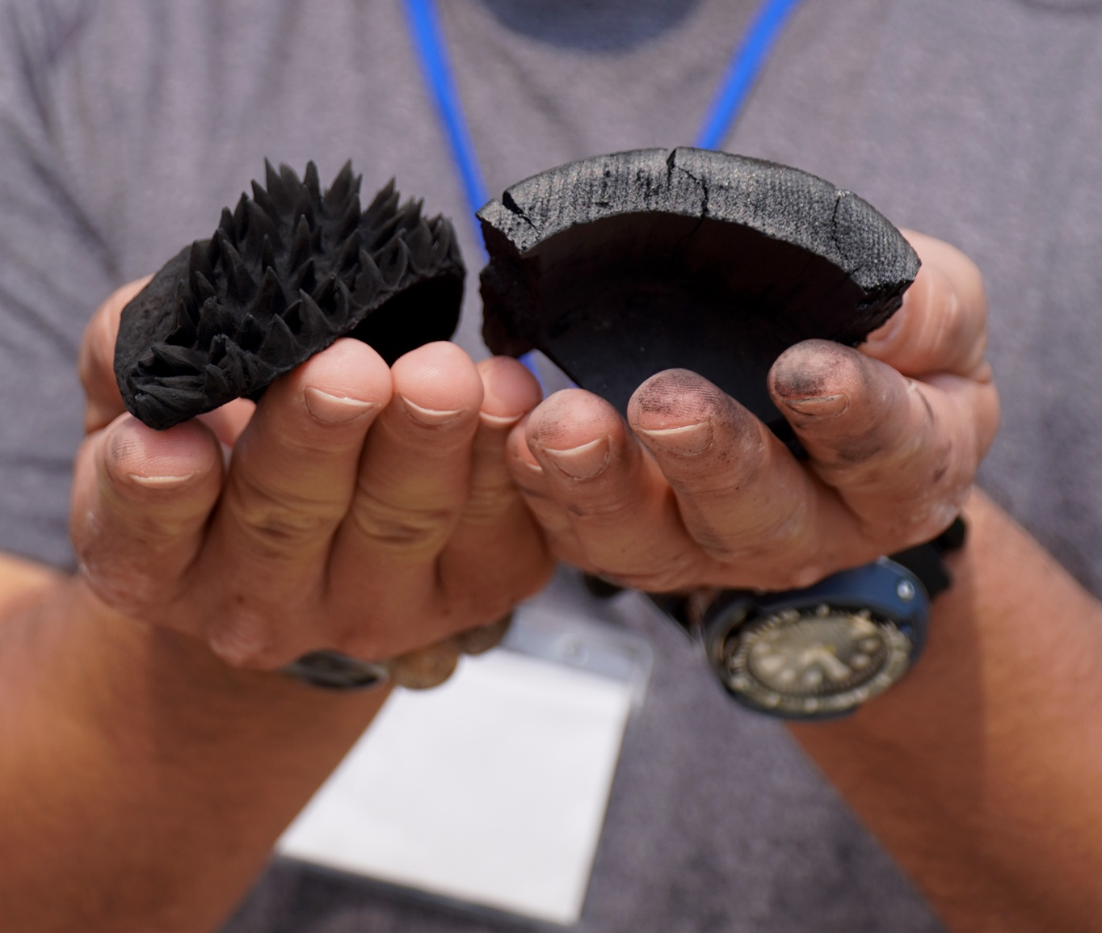
Biochar offers us an opportunity!
Notes:
In conclusion, biochar offers us an opportunity. Instead of allowing organic waste to accumulate in landfills or be burned in open fires, we can make biochar to use in soil restoration, water treatment, and energy production.
Carefully stewarding our resources can lead to less waste, healthier agricultural practices, healthier water systems, and healthier air.
Photo: Biochar Academy 2024, IBI, Lauren Boritzke-Smith.

Slide 38
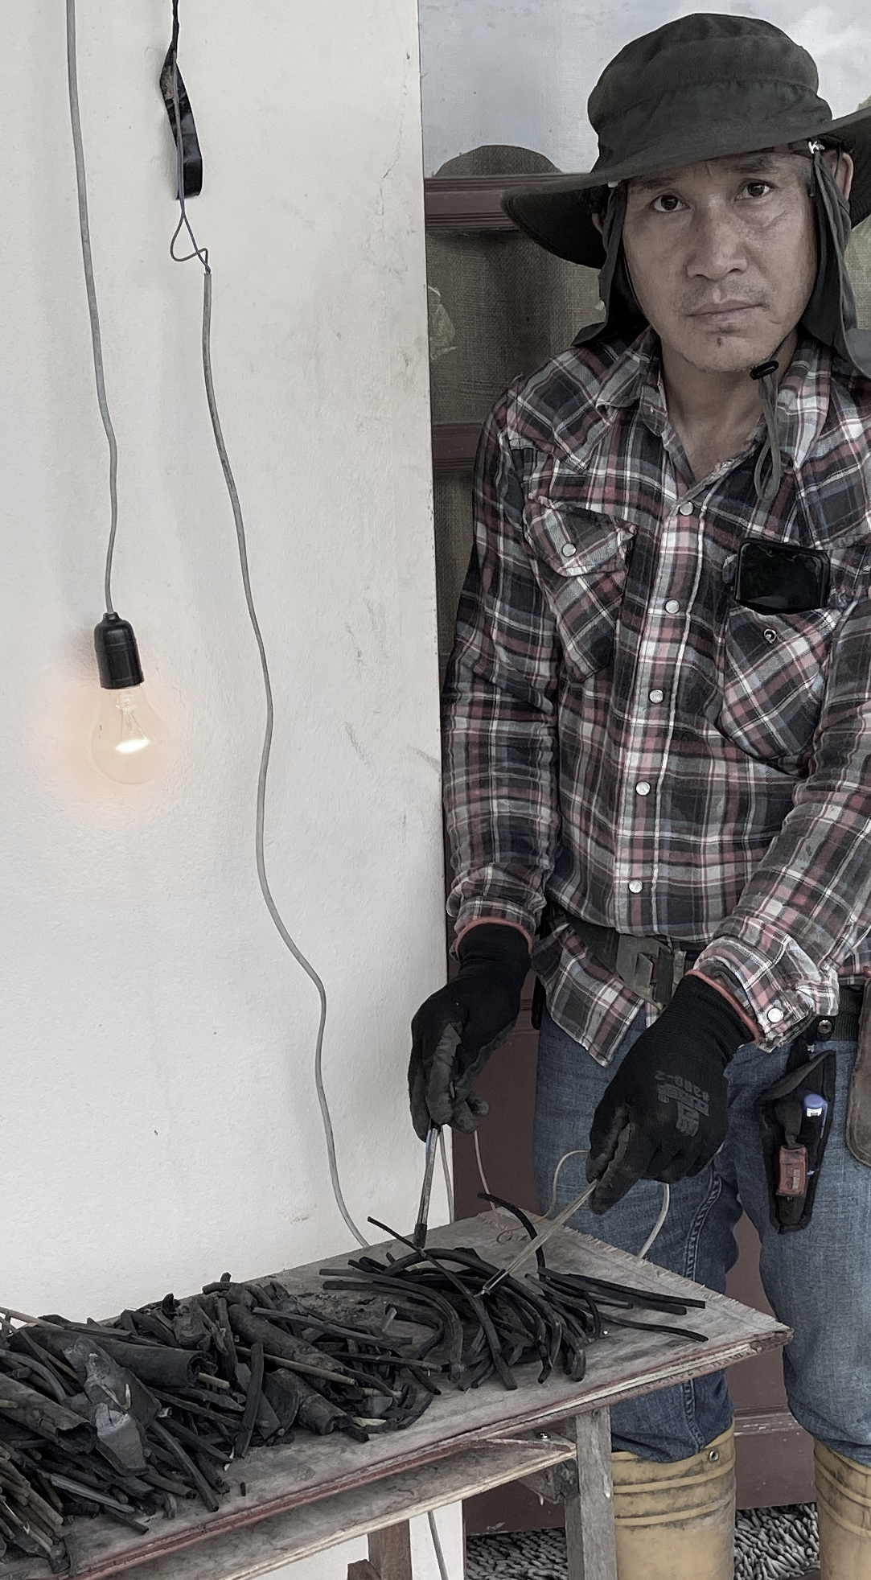
Any Questions?
Notes:
As we wrap up, are there any questions?

